Slide 1
XX
Stream Processing with Actors
Amanda Kabak, CTO/Principal Architect
Notes:
Welcome everyone! Thanks for sharing your time with me this afternoon.
My name is Amanda Kabak. I’m the CTO of CleanSpark, and I’m thrilled to be here to help you squeeze every last bit of value from this excellent conference.
Through the week, we’ve all already learned so many things. I know you’re overflowing with ideas and energy. Your cup overfloweth, right?
Well, let me add one more drop. Wait. One more. And one more after that. Because we’re going to dig into stream processing, also known as the Chinese water torture of the software world. Drip drip drip.

Slide 2
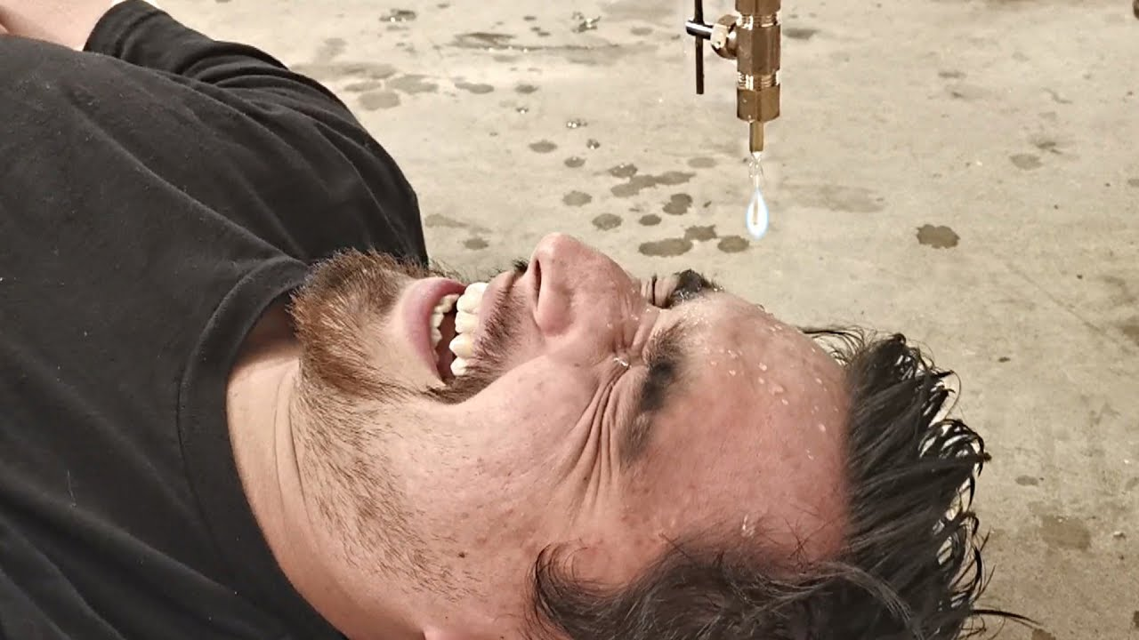
XX
Notes:
You’re lucky I only have 50 minutes!

Slide 3
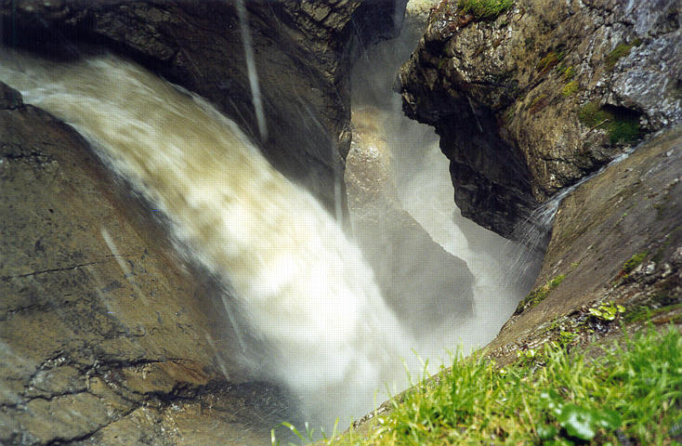
XX
Notes:
Actually, it’s more like this.

Slide 4
What is Stream Processing?
there is value in data!
(… just often not in raw data)
Device
Device
Fault Codes
Metrics
Device
Device
?
Counters
Device
Observations
Device
Device
Wrong Units
Device
Measurements
Device
Device
Serial Numbers
Customer Value
Answers
Roll Ups
Actions
Device
Device
Notes:
Drops of data that LITERALLY NEVER STOP COMING
You’ve probably all been to the doctor lately
Tablets
So much typing
Imagine trying to make sense of patient telemetry? How many patients? How much data
We live in an avalanche of data!
Raw data is massive and unintelligible. [Why]
I mean, have you looked at your email inbox lately? I shudder.

Slide 5
What Is Stream Processing ?
Turning Raw Data into Valuable Insights
(In Near Real Time)
Can be as simple as:
Scaling to expected units of measure
Filtering or flagging outliers
Simple arithmetic for aggregating multiple points
Splitting streams and routing raw data to other batch processes
Persisting to permanent storage
Or as complex as:
Video or image processing
Modeling complex equipment behavior
Rolling or windowed statistics over longer periods of time
Alerting on alarm conditions
AI-based pattern matching
Stream processing is done point-by-point
(Not in Batches)
Notes:
How can we help our customers get value and insights?
Believe me, no one wants to see fault codes. Or, god forbid, temperature in Celsius.
It takes work to go from the forest to the one particular tree.
The needle in the haystack
The lid for your pot
The required processing can go from mild to wild
Simple as unit conversion
Difficult as image processing – turning a scan into a diagnosis

Slide 6
What Is Stream Processing ?
Stream Processing is Challenging and Messy
Data (the problem):
Comes in out of order
Delayed by network latency
Missing entirely
Invalid
Heterogeneous
Logic (compounds the problem):
Slow processing causes bottlenecks
Some processing needs historical data
Hard to visualize/comprehend
Concurrency issues
Hard to test
And it never stops coming!
Notes:
Everyone wants results, and no one wants to hear how hard it is to get them, but it’s hard!
The real world bears no relation to clean laboratory conditions.
We’re in a rough spot. And this constant dripping isn’t helping

Slide 7
What Is Stream Processing ?
CleanSpark’s Stream Processing Problem Statement
We monitor and control industrial electric microgrids.
Microgrids are snowflakes
Different equipment connected in different ways
Green energy technology advancements
Different operational constraints
Configurations change over time
Need a consistent experience across site owners and operators
Same metrics to communicate delivered value
Same operational charts and consistent alarming and alerts
Can’t customize logic per customer
Need to scale to 100s of thousands of points processed per minute
Notes:
Sound familiar? Yeah, we’re all struggling with the same thing.
You are not alone, though it may feel like it.
So not only do we have the drip drip drip of data, that data’s changing all the time.
[Analogy]

Slide 8
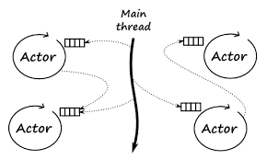
The Actor Model
The coding paradigm, not Meryl Streep

Slide 9
The Actor Model
Fundamentals of the Actor Model
In the actor model, an actor is the universal computational primitive.
Message-based communication
Single-threaded
Stateful but protected
An actor can:
Send messages to other actors
Create new downstream actors
Change its own state and behavior
Notes:
But in one way they’re the same: specialness
A stateful, singleton, nanoservice.

Slide 10
The Actor Model
Benefits of the Actor Model
Actors help solve the problem of concurrency.
The combination of:
Single-threadedness
Process and memory isolation
Location transparency
Results in:
High processing density
Testability
Deterministic results
http://highscalability.com/blog/2016/8/15/how-paypal-scaled-to-billions-of-transactions-daily-using-ju.html
Notes:
In many ways, actors are like you or me.
Don’t multi task
Can’t hear our spouse when the TV’s on
Locatable by our cell phone
But actors are better – and not just because they’re more beautiful

Slide 11
The Actor Model
Actor Frameworks
There are many actor frameworks out there and some differences among them.
For example:
Message vs interface-based communication
Base language implementation vs libraries
Reentrancy allowed vs not allowed
Implementation details aside, most mature actor frameworks operate in similar ways and follow the same rules.
Notes:
Because we’re human, one way of doing things is good, but endless variation is better, right?

Slide 12
The Actor Model
Common Actor Uses
In an actor model, everything is an actor.
Actors are used to model:
Users
Shopping carts
Physical things like thermostats or meters
A “row” of data typically stored in a database
Notes:
Who of you has *not* been on some kind of social media today.
On Facebook and Twitter, we’re things.
In multi-player games, we’re things.
If you’ve ever wondered who would play you in the movie of your life, I’ve got some bad news: this actor is not beautiful or famous but a special collection of bits.
Things are good, but *connections* are better.

Slide 13
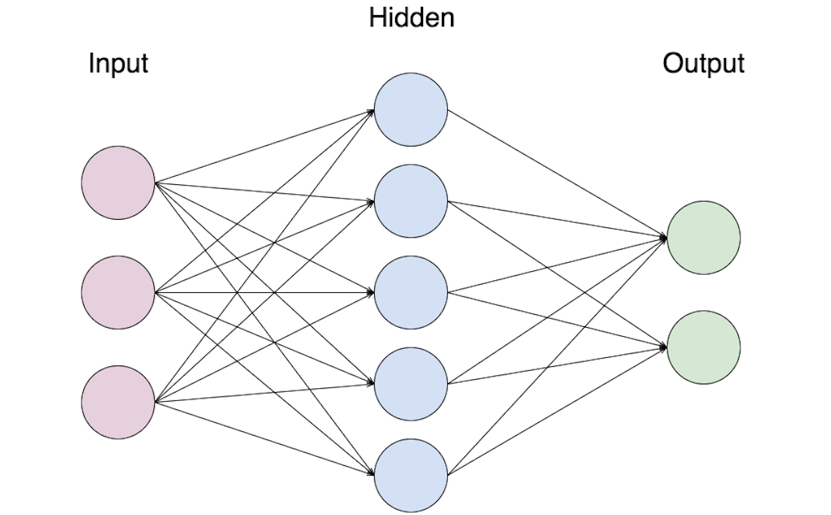
Mesh Processing
What is a Mesh?
In a computing mesh, the power comes not from individual pieces but how those pieces are connected together.
Consider an Artificial Neural Network:
ANNs are used for forecasting, image processing, and character recognition.
In an ANN, each node contains the same logic. The number of nodes and how they are networked together provide the true power.
Notes:
What do I mean by connections?
I don’t know about you, but I’ve got a whole stack of business cards. Building professional networks
Value through integration of simple logic
Mimics interaction of services in a microservice platform
Speaks to reuse – email service needs context
In this same way, the value of an actor is amplified with how it is wired together with other actors.

Slide 14
Mesh Processing
What is a Mesh?
In a computing mesh, the power comes not from individual pieces but how those pieces are connected together.
Consider a sorting mesh:
This one sorts 8 values in 5 steps.
Different number of inputs would require different number of steps
Each tick could result in a fully sorted list.
Actually becomes more efficient with larger number of values
As with ANN, each box contains the same logic
Notes:
Well and good, but why do I need to complicate an already complicated solution with another technology
Two answers: parallelization and, actually, simplicity.

Slide 15
Mesh Processing
Why Meshes need Actors?
Mesh processing requires parallelism and concurrency. Actors deliver these safely.
Each “tick” of mesh execution needs to operate on synchronized data:
“Tick” 1
Set 1
“Tick” 2
Set 2
Set 1
“Tick” 3
Set 3
Set 2
Set 1
“Tick” 4
Set 4
Set 3
Set 2
Set 1
“Tick” 5
Set 5
Set 4
Set 3
Set 2
Set 1
Notes:
This is where the difference between actors and humans shines

Slide 16
Mesh Processing
Mesh Provisioning
Mesh topography can be defined in three different ways:
At design time
The shape of the mesh is well known and unchanging
Examples include: LED signs, single plant monitoring
Based on pre-configured data
The shape of the mesh is codified within a set of data
The mesh shape is created during a discrete provisioning process
Examples include: ANN, health monitoring, anomaly detection
At run time
The shape of the mesh changes based on the data flowing through it
Examples include: social networks
Notes:
Okay, so now we understand
The horror of stream processing
The concept of actors
The power of meshes
The question now is how do I get started?
By defined, I mean more like created.
How and where is this mesh actually get wired up?
How do we define what actors we use and how they’re connected?

Slide 17
Mesh Execution
Perpetual Motion
The edges of the mesh serve as I/O boundaries, and the mesh executes internally, ideally without external interaction.
Input 1
Can be pushed in parallel
Output 1
Can be read or published in parallel
Input 2
Output 2
Input 3
Notes:
Voila, we have a mesh!
Now how do I turn it on?
Just push data
No internal I/O

Slide 18
Mesh Execution
Throughput and Flow
Meshes thrive under consistent, not bursty flow. Remember the sorting mesh.
Each actor has its own queued inbox.
Only one message will be processed at a time.
Bursts will get queued, but parallelization can increase total throughput.
“Tick” 1
Set 1
“Tick” 2
Set 2
Set 1
“Tick” 3
Set 3
Set 2
Set 1
“Tick” 4
Set 4
Set 3
Set 2
Set 1
“Tick” 5
Set 5
Set 4
Set 3
Set 2
Set 1
Coordination and parallelization can be configured.

Slide 19
Mesh Execution
Throughput and Flow – Supervising Actor
Site1
Sets of data
Site-wide commands
Reprovisioning
Site1.FN1.PV1.Power (kW)
Site1.FN1.PV2.Power (kW)
Pushes sets of data to a top-level, supervising actor ensures coordinated calculations
Site1.FN1.PV1.Energy (kWh)
The supervisor can parallelize, or calling code can parallelize calls to the supervising actor
Site1.All.Agg.PV (kW)
Site1.FN1.PV2.Energy (kWh)
Site1.All.Agg.PVkWh (kWh)
Site1.FN1.PV1.15MinkWh (kWh)
Site1.FN1.PV2.15MinkWh (kWh)
Site1.All.Agg.MTDPV (kWh)
Site1.All.Agg.PV15MinkWh (kWh)
Notes:
Now, some of you may be picturing something like “Actors gone wild” in your mind.
How do we keep the flow straight? How do we maintain sets of information?

Slide 20
Change Management
Mesh Provisioning
If your mesh is based on preconfigured data, you will need a tool to provision it.
NodeId | NodeType | InitialState
Site1 | Supervisor | Null
Tag1 | Raw | Null
Tag2 | Running Total | 0
… | … | …
Site1
Convert Data
Tag1
EdgeId | Source | Destination
1 | Tag1 | Tag2
2 | Tag1 | Tag3
3 | Tag2 | Tag4
4 | … | …
To Runtime Execution
Tag2
Tag3
Tag4
Notes:
How do you make meshes comprehensible?
How do you determine if they’re valid?
How do you maintain consistency?

Slide 21
Change Management
Mesh Visualization
Meshes can be queried for their current structure
Mesh visualization is critical to tracing calculation flow:
Makes the mesh comprehensible
Flow can be validated by the business
Can enable the creation of integration tests if necessary
[DEMO!!]

Slide 22
Conclusions
Actor meshes are well suited to stream processing
Provisionable on the fly
Infinitely testable
Thread safe
Scalable (processing density vs cost against serverless)
Comprehensible (visualize mesh)
Flexible
Composable (in meshes and actors themselves)
PLEASE RATE THIS SESSION ON CONFERENCE WEBSITE OR APP!

